Slide 1
INVESTMENT CASE STUDY SUBMISSION
Group Name: ZEN’DS
Anupam Majhi
Lijo Thomas
Hari Nyshadam
Snigdh Shwetank

Slide 2
Abstract – Spark Funds Investment Decision
Business Objective
To identify the best sectors, countries, and a suitable investment type for making investments.
Strategy
To invest where most of the investors are investing.
Goals of Data Analysis
Investment type analysis: Understanding investments in different categories to help Spark Funds decide on the best suited investment for the strategy.
Country analysis: Understanding which countries have had the most investments in the past.
Sector analysis: Understanding the distribution of investments across the eight main sectors.
Investment Constraints
Invest between 5 to 15 million USD per round of investment.
Invest only in English-speaking countries because of the ease of communication with the companies.

Slide 3
Problem Solving Methodology
Business Understanding
Understand Data
Collect relevant data
Describe datasets
Explore data by plotting graphs
Check data quality
Data Preparation
Select relevant data
Clean data
Construct: Derive new features
Integrate Data
Format Data
Business Objective
Data Analysis Goals
Datasets
Data Modelling
And
Analysis
Create Reports and Generate Results
Analyse Reports
Presentation
Decision Making
Model Evaluation

Slide 4
Investment Type Analysis
Investment Types were limited to four types as per Spark Funds’ preference:
Venture
Angel
Seed
Private Equity
The highest average investments are made in “Private Equity”
Spark Funds’ desired investment range per round : 5 to 15 million
Venture funding is the suitable type in this case.

Slide 5
Country Analysis
Countries have been filtered based on:
Investment type : Venture
Total Investment in the country
These are the Top 9 countries based on total investment:
Based on language preference as English, few countries are excluded
Country | Total Investment (USD)
USA | 422510842796
CHN | 39835418773
GBR | 20245627416
IND | 14391858718
CAN | 9583332317
FRA | 7259536732
ISR | 6907514579
DEU | 6346959822
JPN | 3363676611

Slide 6
Sector Analysis
Based on the top 3 countries i.e.
USA
GBR
IND
Others Sector is the most number of times invested sector in all top 3 countries
Social, Finance, Analytics, Advertising Sector holds the second place in all top 3 countries.
Cleantech / Semiconductors holds 3rd place in USA and GBR, whereas in IND the News, Search and Messaging category holds 3rd place.
 | USA | GBR | IND
Total number of Investments (count) | 12150 | 628 | 330
Total amount of investment (USD) | 108531347515 | 5436843539 | 2976543602

Slide 7
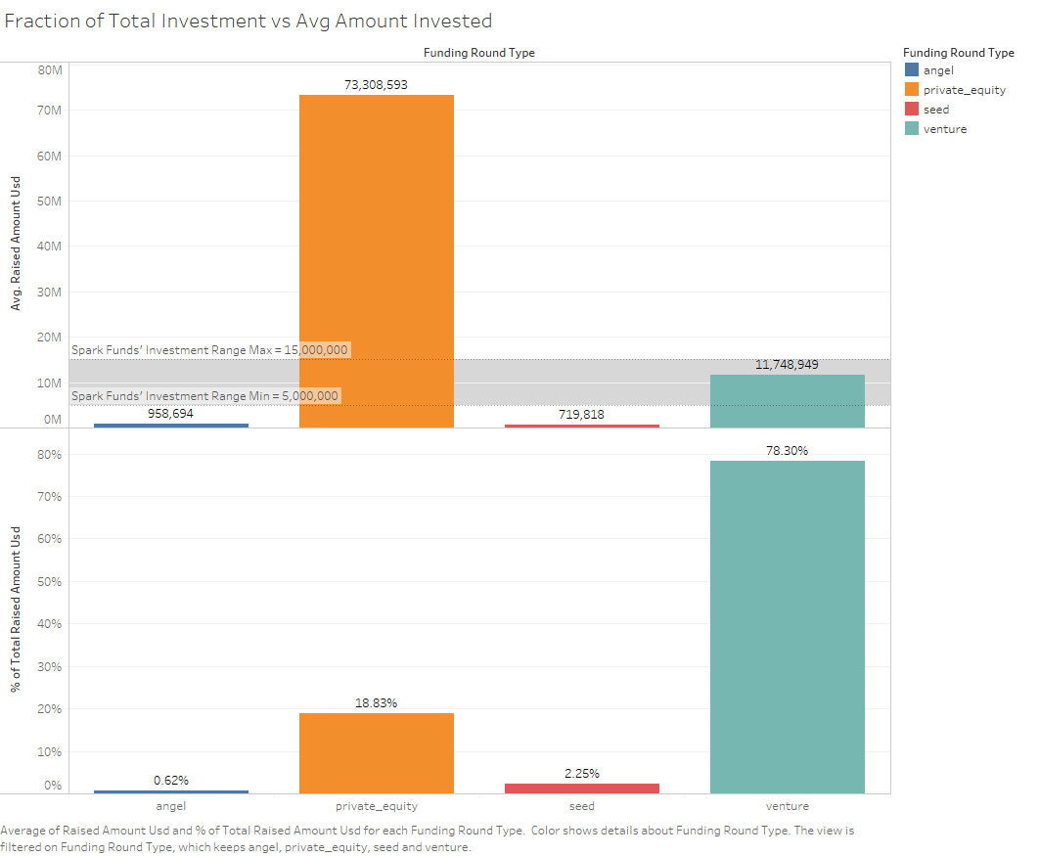

Slide 8
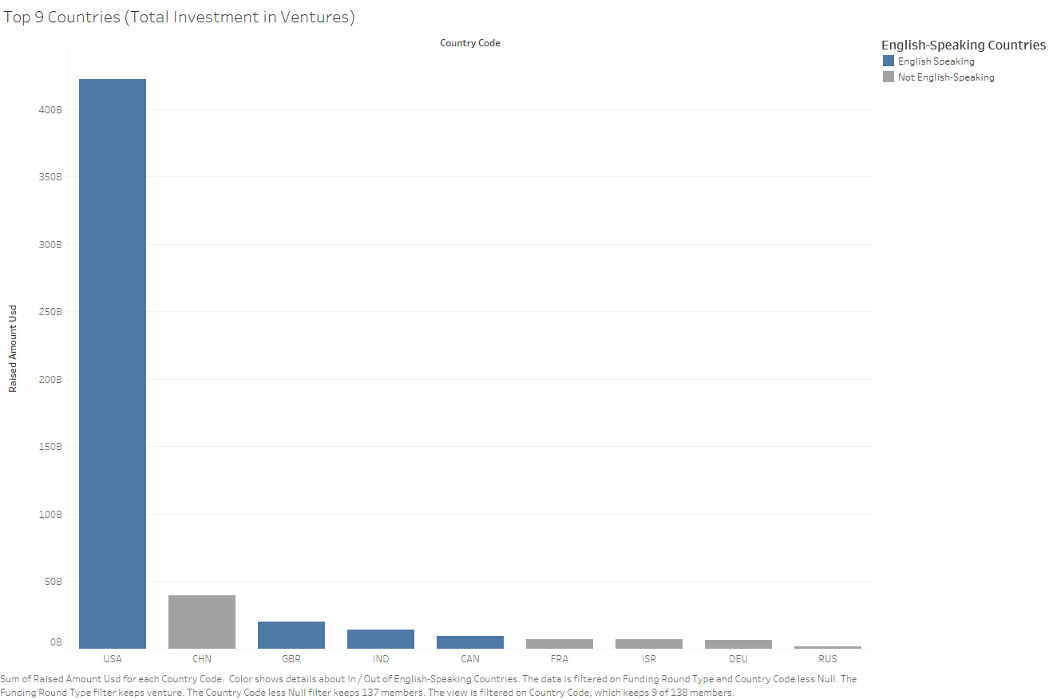

Slide 9
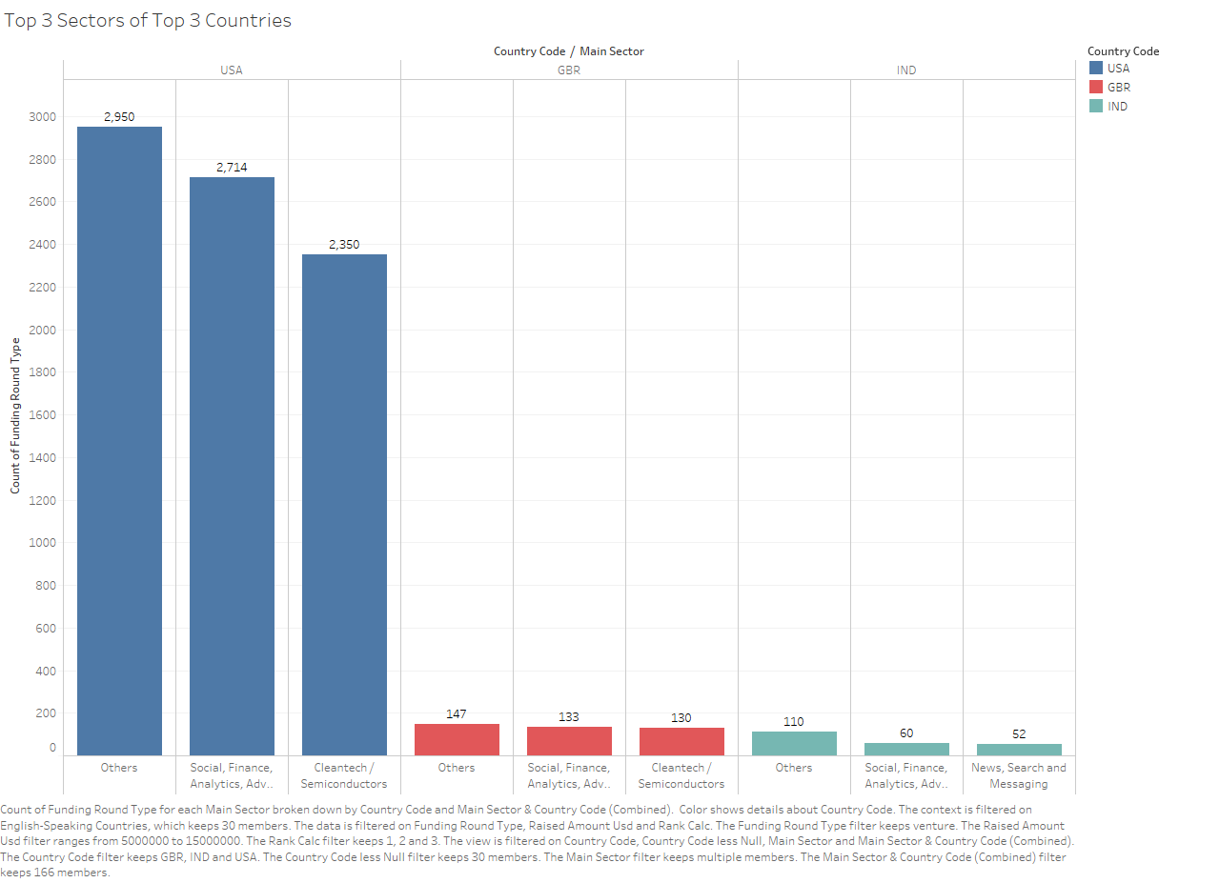

Slide 10
Conclusions
The type of fund to invest in is the “Ventures”
Meets Spark Funds’ range criteria
Has the highest total investment among the for chosen types.
Best type among the four investment types preferred.
The Venture investment in the “Others” sector is the highest among all the top 3 countries.
It is followed by “Social, Finance, Analytics, Advertising” sector, which seconds in all the top 3 countries.
“Cleantech / Semiconductors” sector is another third place winner among these sectors in USA and GBR, whereas “News, Search and Messaging” sector wins the third place in IND.
Hence we can recommend a Venture investment in these sectors.
USA wins when it comes to amount of investment and number of investments by far.
Investing in USA seems to be a good starter. However GBR and IND have almost the same opportunity.
Considering India’s growth in the last few years, IND seems to be a great country to invest in.

